Slide 1
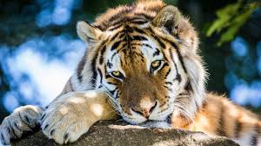
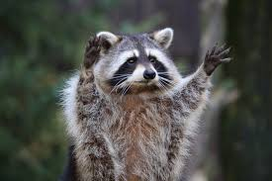
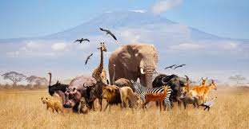
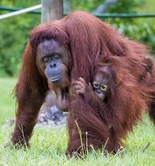
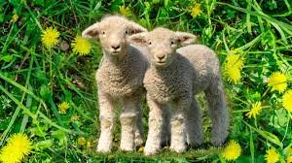
Autumn term writing competition 2024.

Slide 2
How to enter:
Look at the task for your year group.
Complete the task.
Hand in to Miss Davies or Miss Saddington
by Friday 29th November 2024.
Why enter:
To improve your writing.
To have your work published in our school book
To receive a certificate
To be in with a chance to win a prize.

Slide 3
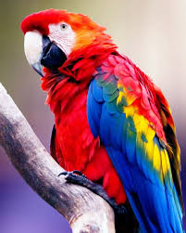

Reception - Choose an animal and describe it.
bird
red
wings
yellow
beak
blue
parrot
Write a sentence about your animal.

Slide 4
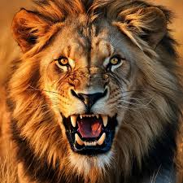
Year One - write a description of your animal.
The Lion has sharp teeth. He has lots of fur and his mane is very fluffy.
His eyes are a golden colour. The lion's roar is very loud.
Can you include some conjunctions?
and because but so

Slide 5
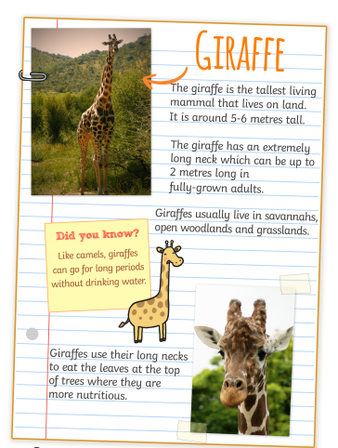
Year 2 - Write a fact file about an animal.
Use a range of conjunctions

Slide 6
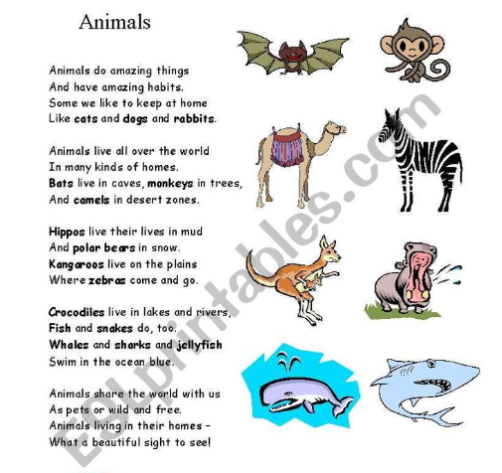
Year 3 - Write a poem about your animal
Have you included:
Similes
Metaphors
Alliteration
Personification
Expanded noun phrases.

Slide 7
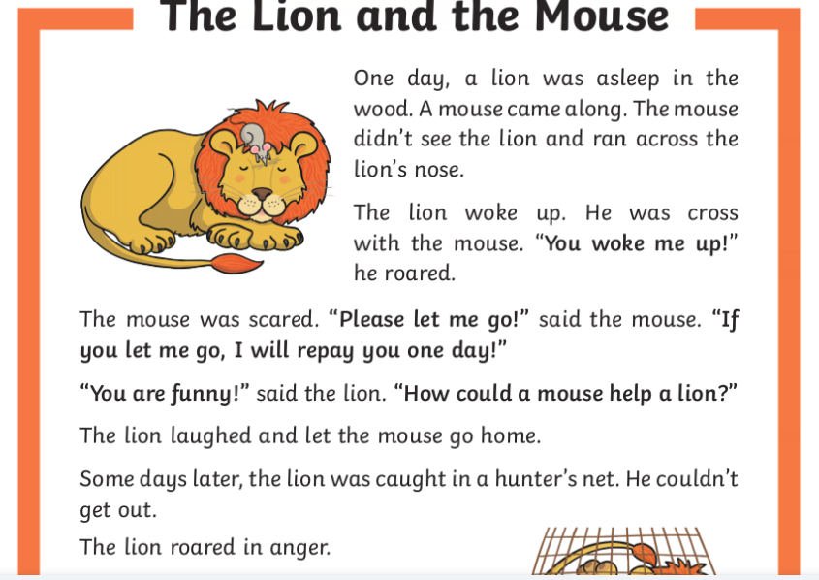
Year 4 - Write a story with animals as characters.
Can you include:
A range of sentence openers.
A range of conjunctions,

Slide 8
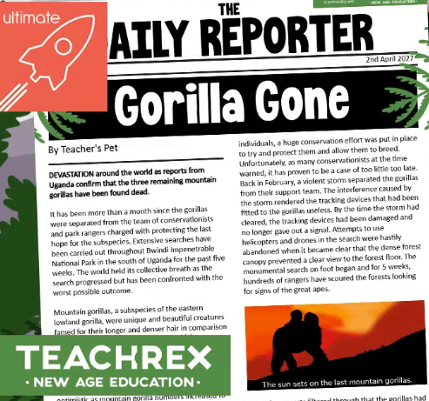
Year 5 - Write a fictional newspaper article about your animal.
Include direct and indirect speech.

Slide 9
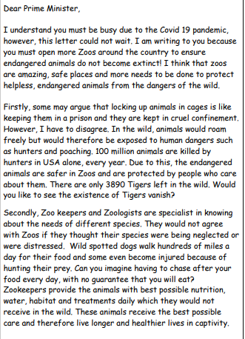
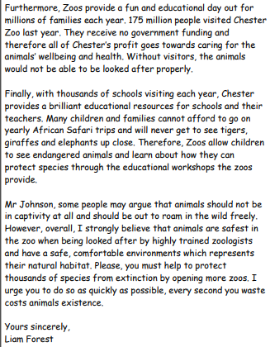
Year 6 - write a persuasive letter for or against keeping animals in zoos.
Include:
-Emotive language
-A range of sentence structures.
-A range of punctuation.

