Slide 1
Parental Engagement Survey - 2021-22
In December 2021 many of you responded to our Parent Survey. As a school, we very much value the feedback from parents. The results of the surveys allow us to develop as a school and help us ensure that our students receive the best quality education possible. We will be using your comments and suggestions to further improve the school in the future so thank you so much to everyone who took the time to complete it.

Slide 2
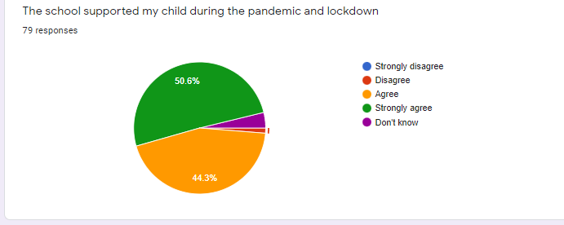
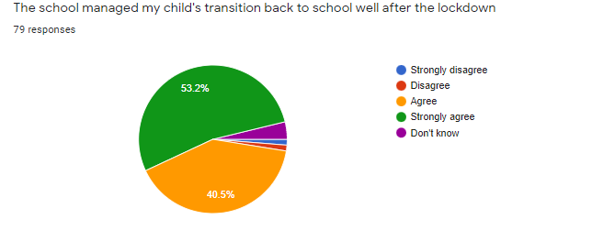
Parental Engagement - lockdown

Slide 3
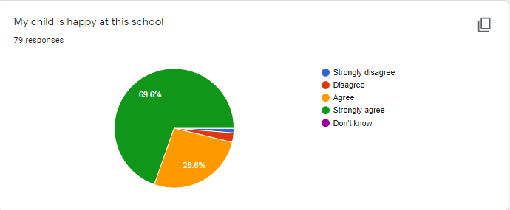
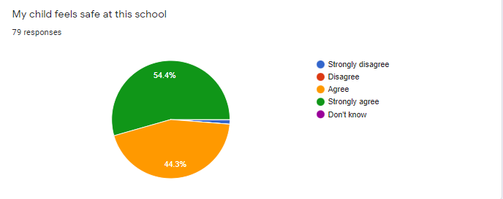
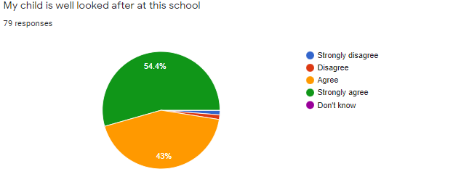
Parent Survey - pupil well being

Slide 4
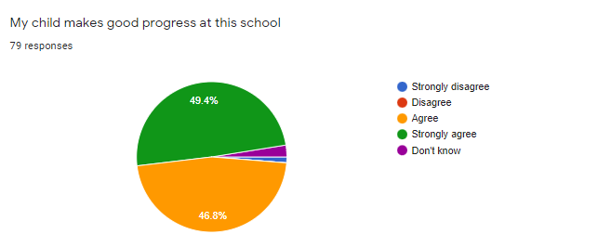
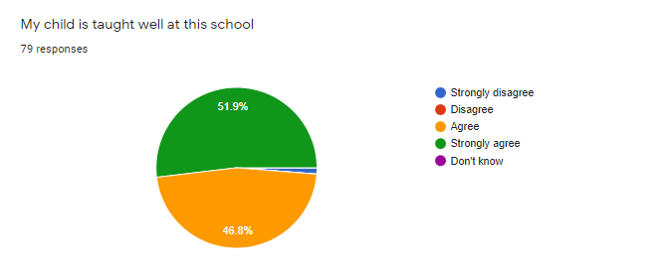
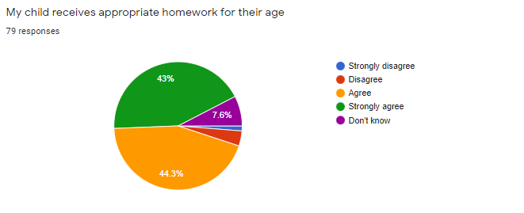
Parent Survey - learning

Slide 5
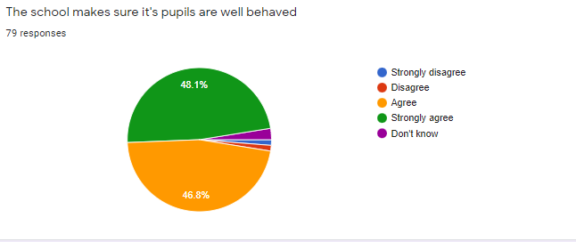
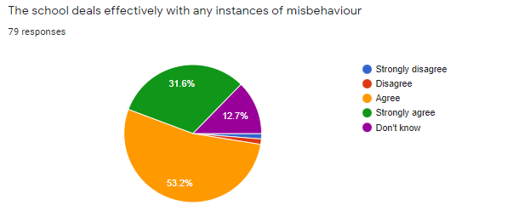
Parent Survey - behaviour

Slide 6
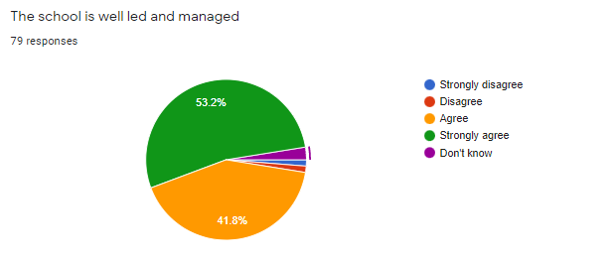
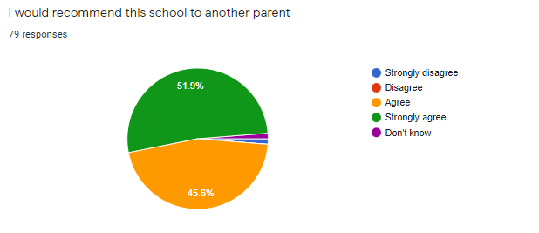
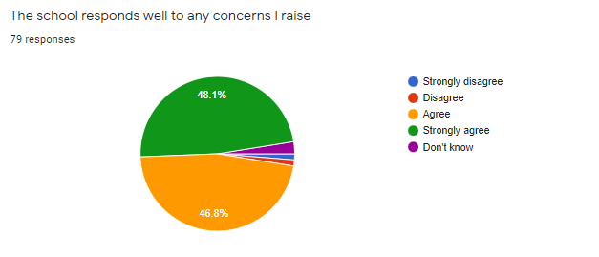
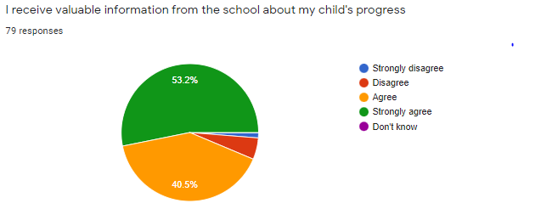
Management

